Slide 1

Google Colab Quick Tutorial

Slide 2
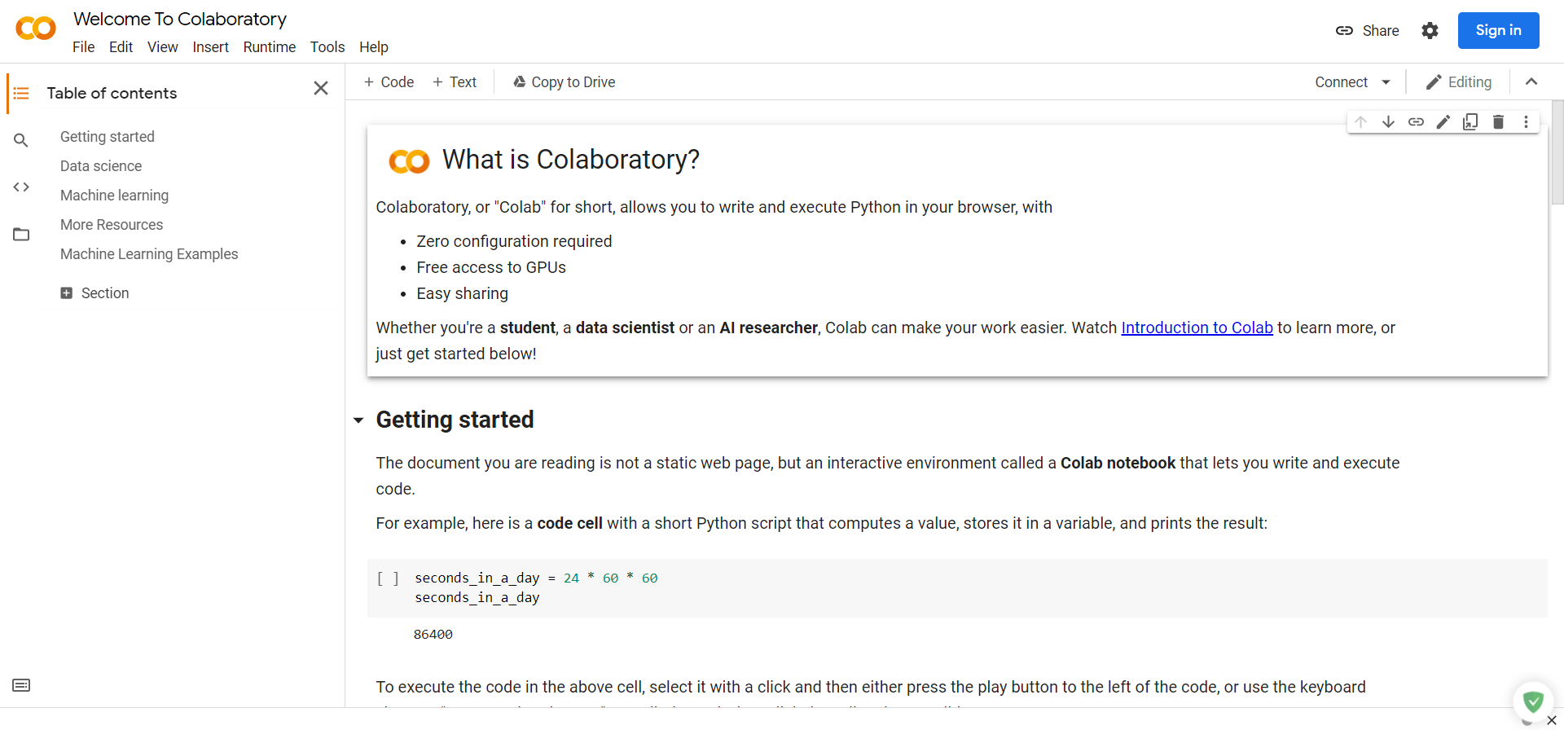

Slide 3
What is Google Colab?
Colaboratory, or "Colab" for short, allows you to write and execute Python in your browser, with:
  Zero configuration required
  Free access to GPUs
  Easy sharing
Colab notebooks execute code on Google's cloud servers, meaning you can leverage the power of Google hardware, including GPUs and TPUs, regardless of the power of your machine. All you need is a browser.
You can change the hardware accelerator from runtime → change runtime type

Slide 4
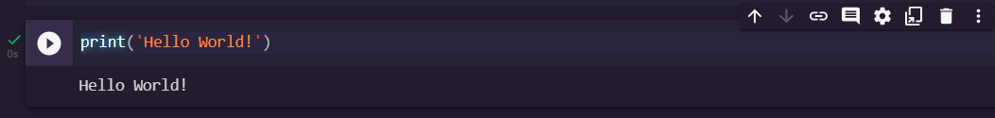
Code Cells
A notebook is a list of cells. Cells contain either explanatory text or executable code and its output. Click a cell to select it.
There are 2 types of cells in notebook, Text Cells and Code cells:
You can add new cells by using the + CODE and + TEXT buttons that show when you hover between cells. These buttons are also in the toolbar above the notebook where they can be used to add a cell below the currently selected cell.
Running a Code cell:
Click the Play icon in the left gutter of the cell;
Type Cmd/Ctrl+Enter to run the cell in place;
Type Shift+Enter to run the cell and move focus to the next cell (adding one if none exists)
Type Alt+Enter to run the cell and insert a new code cell immediately below it.

Slide 5
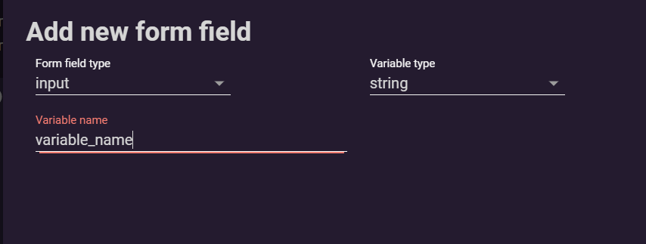
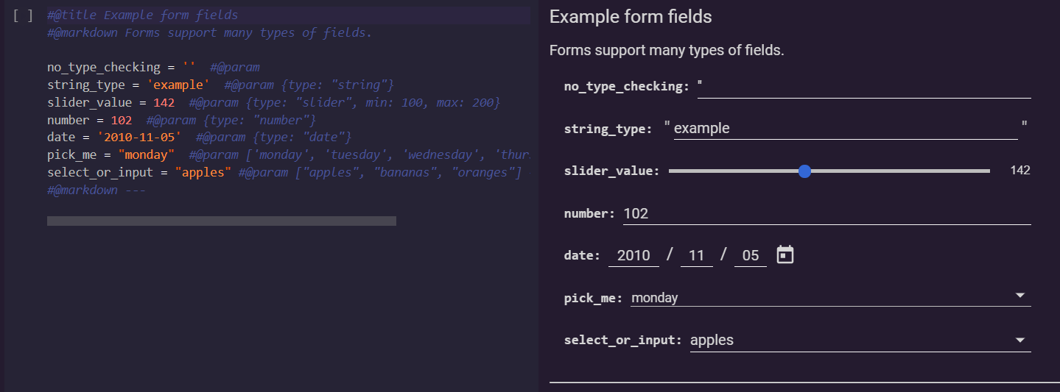
Forms
Forms provide an easy way to parameterize code.
To add a new form field: insert → add a form field
You can change the view of the form by selecting Edit → Show/hide code or using the toolbar above the selected code cell.

Slide 6
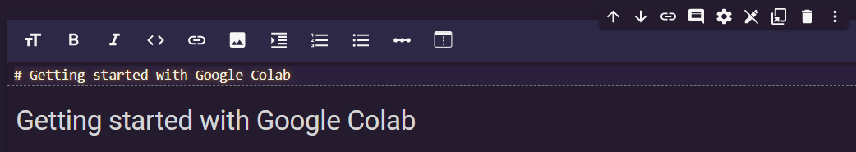
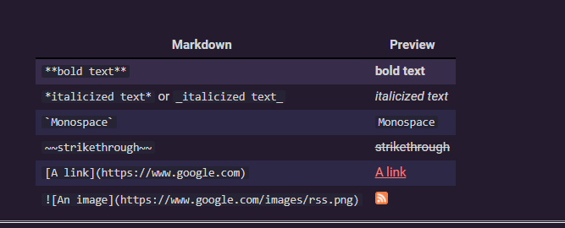

Text Cells
Equations Writing: Just place the statement within a pair of $ signs:

Slide 7
More on cells
Cells selection: Consecutive cells can be selected by dragging from outside one cell and through the group. Non-adjacent cells can be selected concurrently by clicking one and then holding down Ctrl while clicking another. Similarly, using Shift instead of Ctrl will select all intermediate cells.
Interrupting Execution: Long running python processes can be interrupted. Run the following cell and select Runtime -> Interrupt execution (hotkey: Cmd/Ctrl-M I) to stop execution.
Clear Output: you can select the cell and clear the output by either:
  Clicking on the clear output button (x) in the cell toolbar.
  Right clicking the left gutter of the output area and selecting "Clear output" from the context menu.
Automatic completions:
  Colab provides automatic completions to explore attributes of Python objects, as well as to quickly view documentation strings.
  Completions can be opened again by using Ctrl+Space.

Slide 8
Comments
If you have edit or comment permissions you can comment on a cell in one of three ways:
Select a cell and click the comment button in the toolbar above the top-right corner of the cell.
Right click a text cell and select Add a comment from the context menu.
Use the shortcut Ctrl+Shift+M to add a comment to the currently selected cell.
You can resolve and reply to comments, and you can target comments to specific collaborators by typing +[email address] (e.g., +user@domain.com). Addressed collaborators will be emailed.
The Comment button in the top-right corner of the page shows all comments attached to the notebook

Slide 9
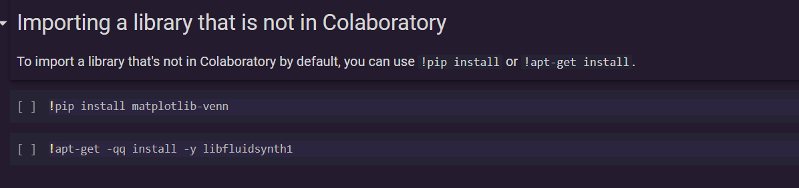
Importing and installing libraries

Slide 10
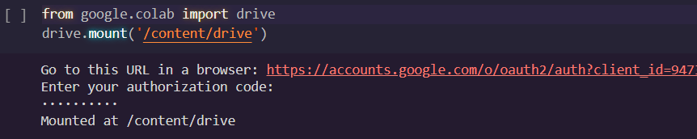
Integrating with Drive
Colaboratory is integrated with Google Drive.
The SHARE button (top-right of the toolbar) allows you to share the notebook and control permissions set on it.
File->Make a Copy creates a copy of the notebook in Drive.
File->Save saves the File to Drive. File->Save and checkpoint pins the version so it doesn't get deleted from the revision history.
File->Revision history shows the notebook's revision history.
Mounting Google Drive in colab

Slide 11
Loading notebooks from Github
Loading Private Notebooks
Loading a notebook from a private GitHub repository is possible, but requires an additional step to allow Colab to access your files. Do the following:
Navigate to http://colab.research.google.com/github .
Click the "Include Private Repos" checkbox.
In the popup window, sign-in to your Github account and authorize Colab to read the private files.
Your private repositories and notebooks will now be available via the github navigation pane.
Clone a Github repository:
! git clone repo_link

